Slide 1


Supervised and Unsupervised Learning
A course on “Data Science with Python”
Malleswar Yenugu, PhD

Slide 2
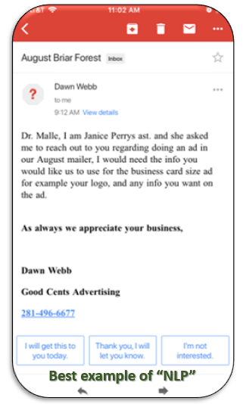
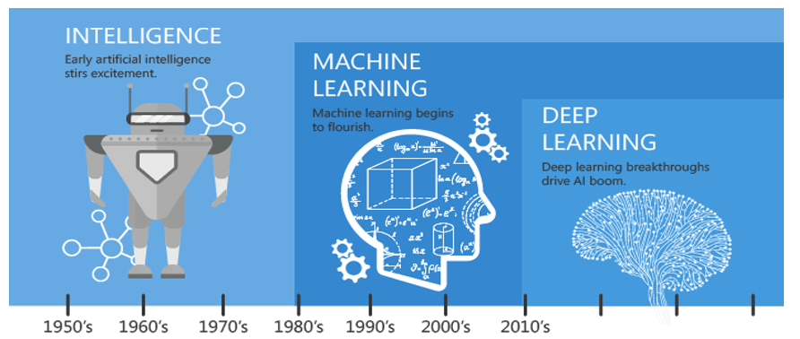
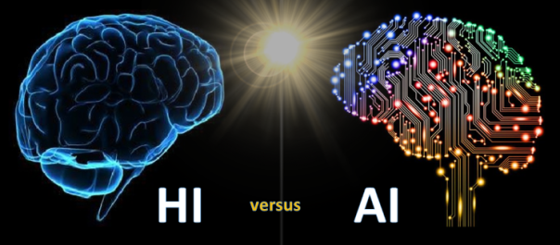
Recap…

Slide 3
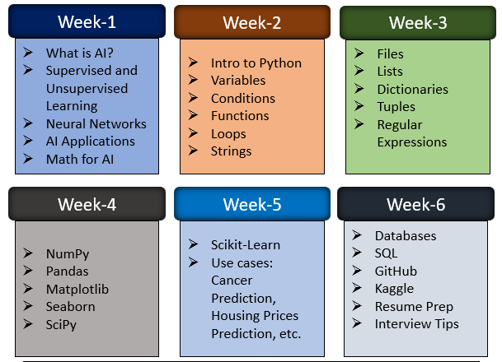
Course Outline

Slide 4
Branches of AI
Artificial Intelligence
Machine Learning
Supervised Learning
Unsupervised Learning
Reinforcement Learning
Neural Networks and Deep Neural Networks

Slide 5
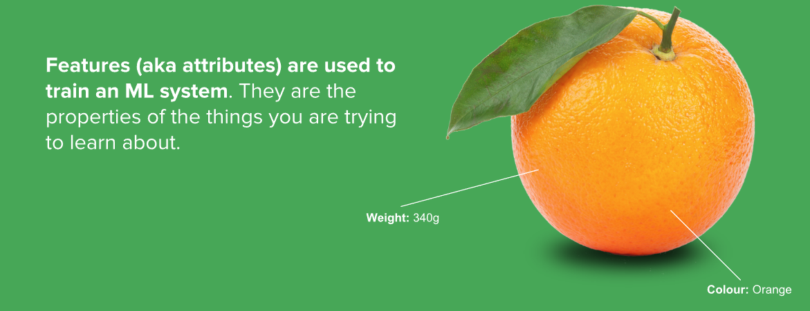
Features/Attributes

Slide 6

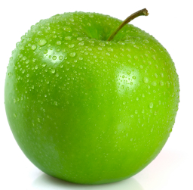
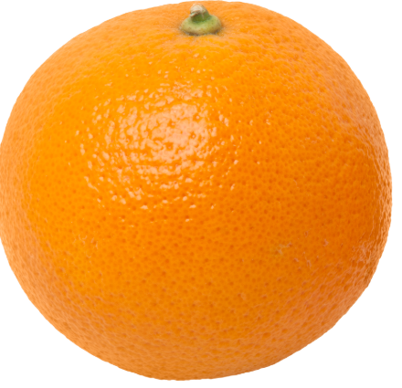
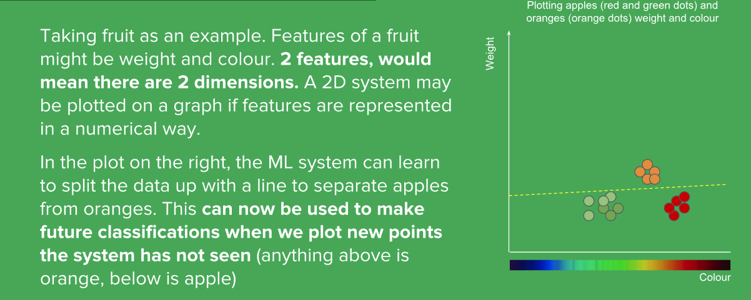
Features/Attributes

Slide 7
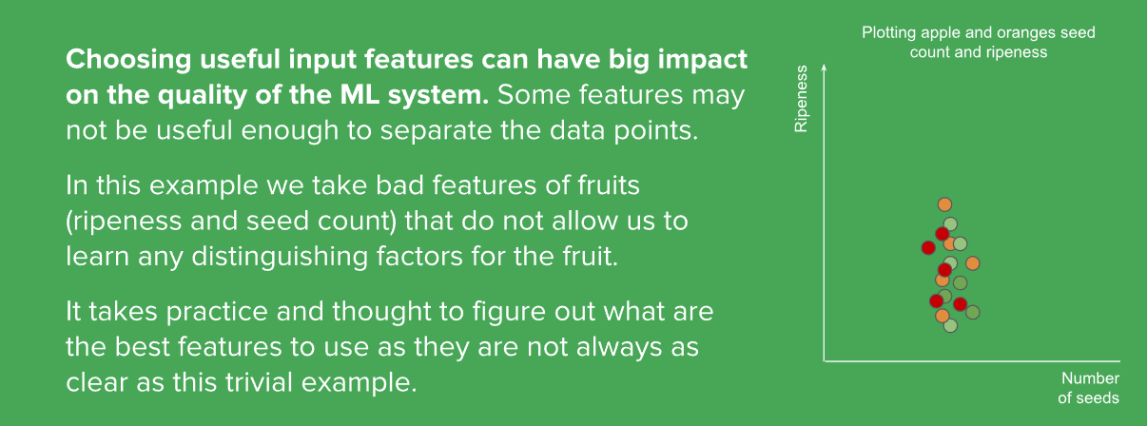
Features/Attributes

Slide 8
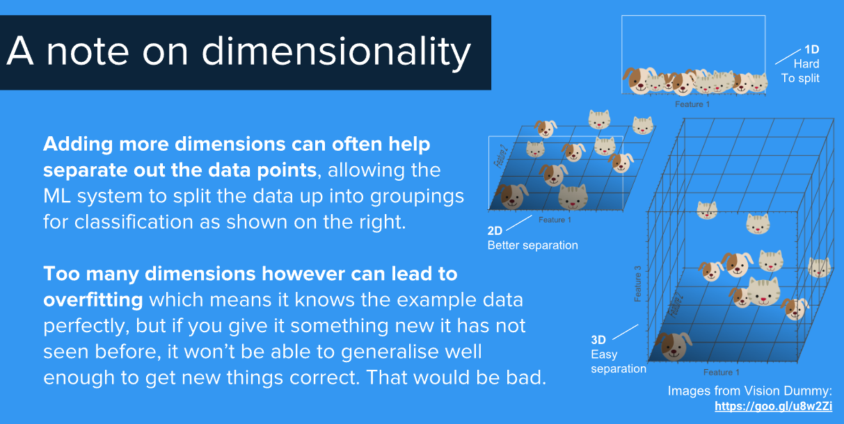
Multi Attributes/Dimensions

Slide 9
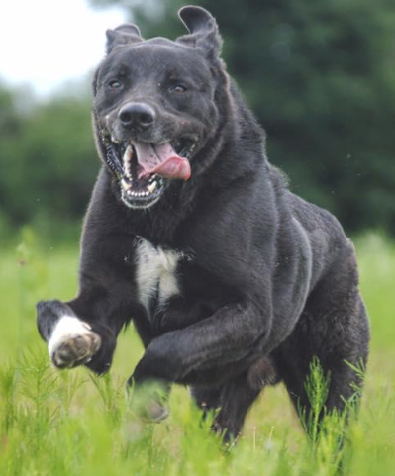
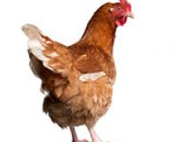
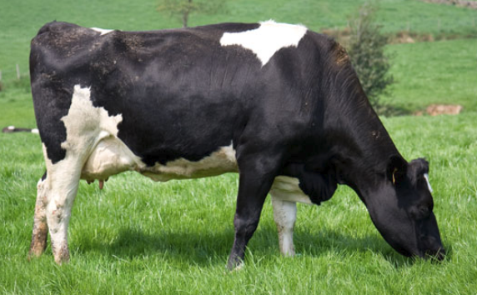
ML cannot predict stuff it does NOT know (trained) about…
DOG
CHICKEN
ML Training
4 Legs
20 lbs
2 Legs
10 lbs
Black
Orange
ML Prediction
DOG

Slide 10
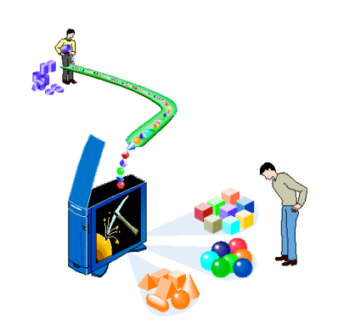
What we will cover Today?
Supervised Learning
- Regression
- Classification
- Decision Trees
Unsupervised Learning
- Clustering
- Dimensionality Reduction
- Association
Quiz

Slide 11
What we will cover Today?
Supervised Learning
- Regression
- Classification
- Decision Trees
Unsupervised Learning
- Clustering
- Dimensionality Reduction
- Association
Quiz

Slide 12
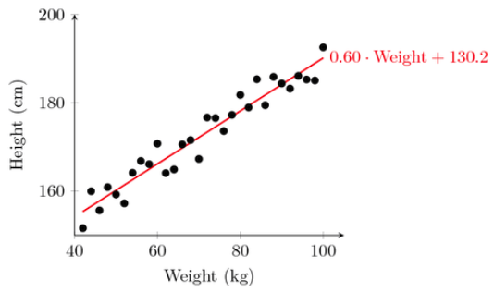
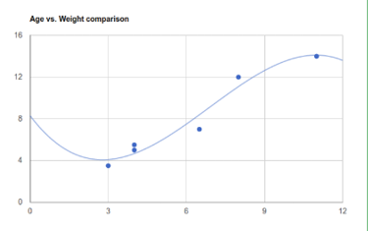
Supervised Learning: Regression
Linear
Non-linear
Regression – You can predict X or Y for a given X or Y – Supervised Learning
Regression is a CONTINUOUS output (numerical)

Slide 13
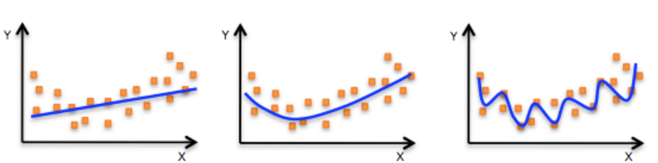
Fitting the data
Under-fitting
Better-fitting
Over-fitting
What if you have more than 2 attributes/dimensions?

Slide 14
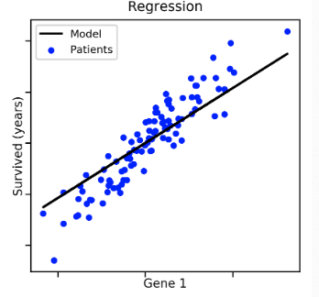
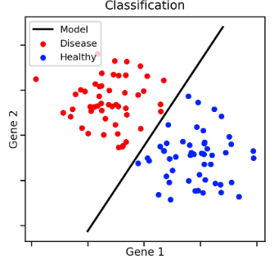
Supervised Learning: Classification
Classification – Determines the class or category based on inputs – Supervised Learning
The output is a label not a number like regression

Slide 15

Classification: Examples

Slide 16
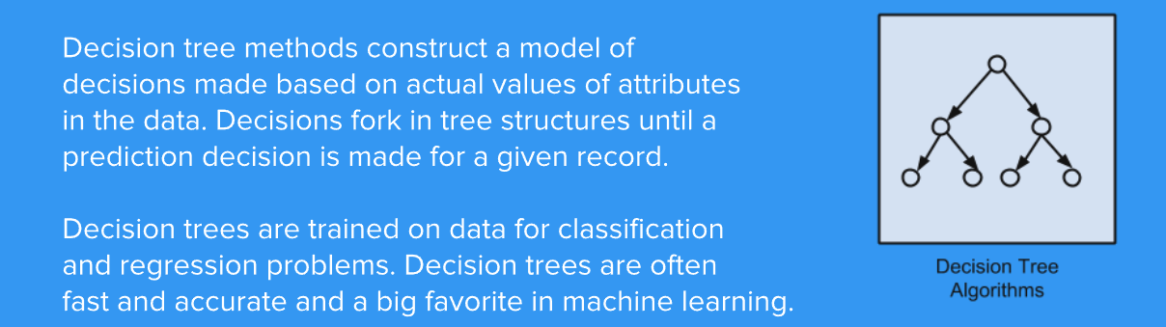
Supervised Learning: Decision Trees

Slide 17

Decision Tree: Example
Decision Tree is also a type of REGRESSION/CLASSIFICATION with multiple variables

Slide 18

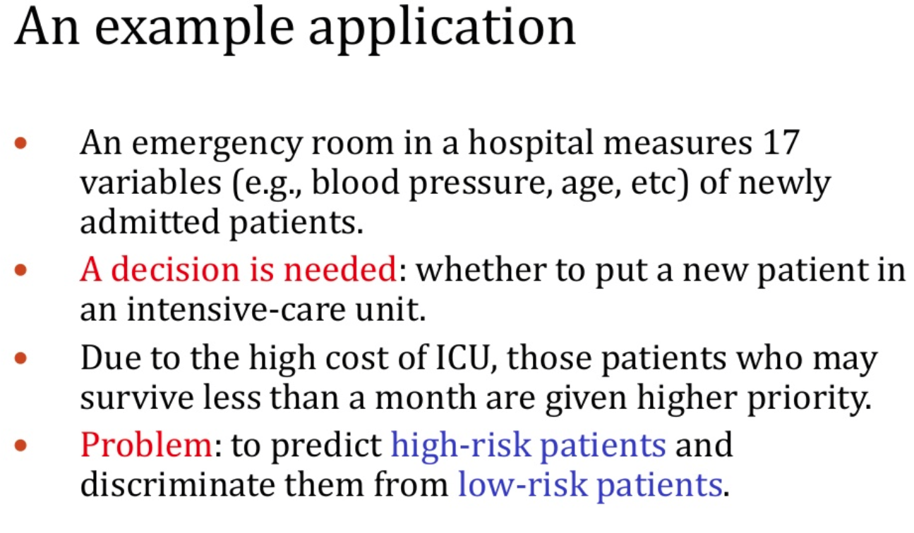
Decision Tree/Classification: Example

Slide 19
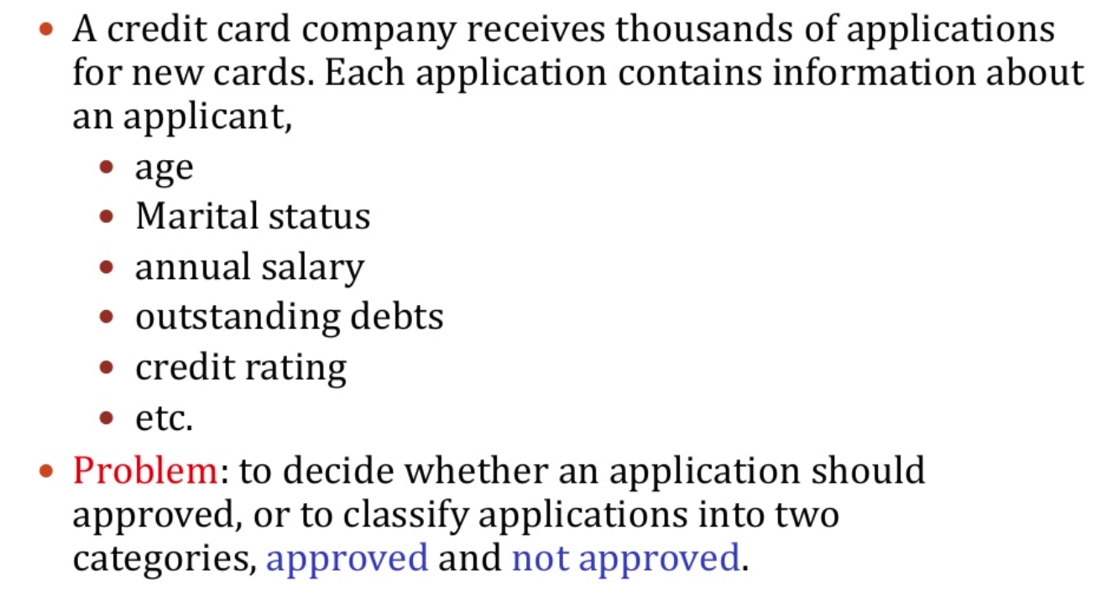
Decision Tree/Classification: Example
age
married
salary
debts
credit
zip
Approved
Not Approved

Slide 20
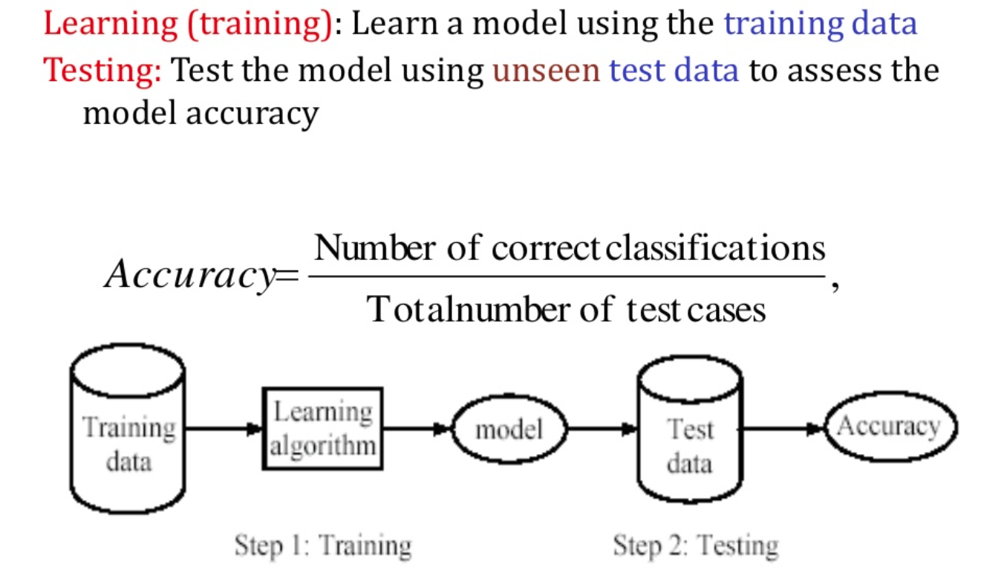
Supervised Learning Process: Two steps

Slide 21
What we will cover Today?
Supervised Learning
- Regression
- Classification
- Decision Trees
Unsupervised Learning
- Clustering
- Dimensionality Reduction
- Association
Quiz

Slide 22
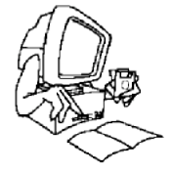
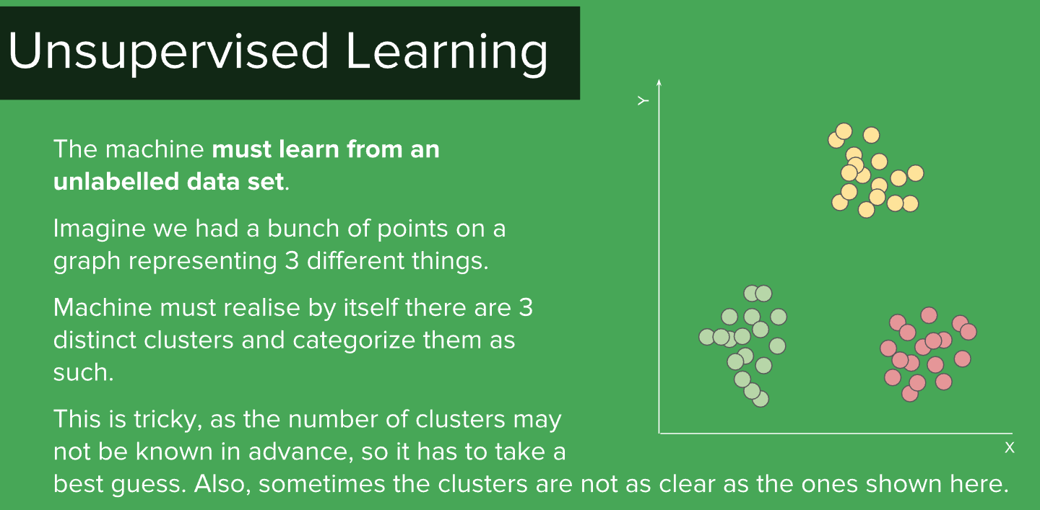
Unsupervised Learning: Clustering

Slide 23
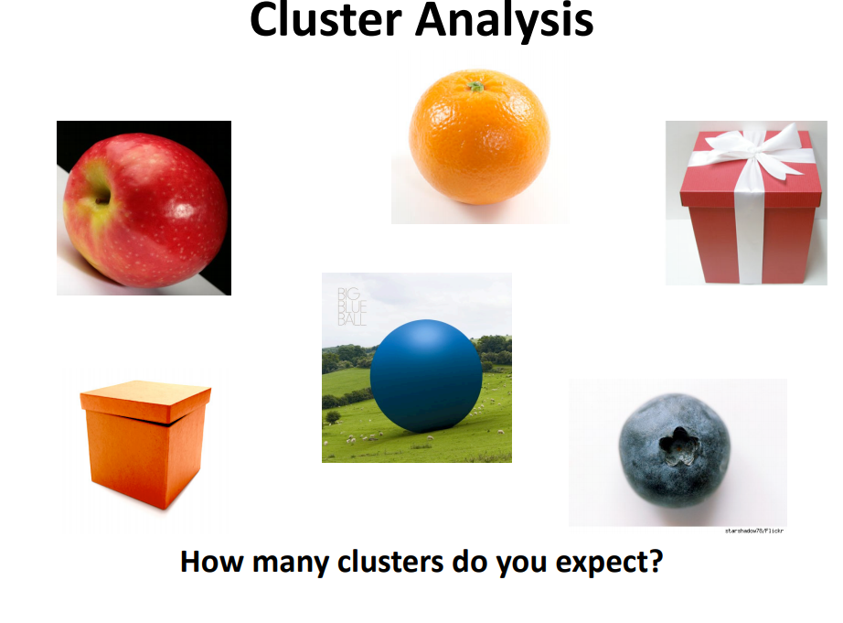

Slide 24
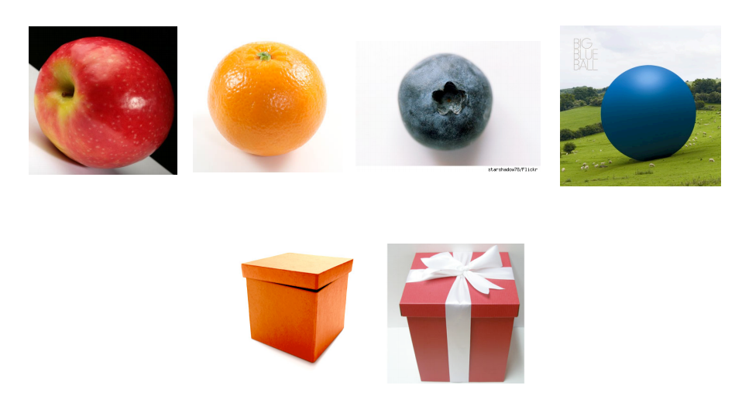
Shape

Slide 25
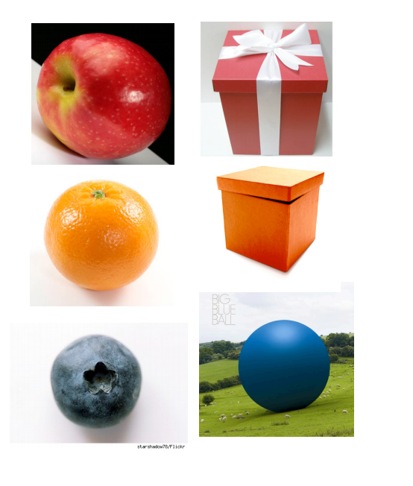
Type

Slide 26
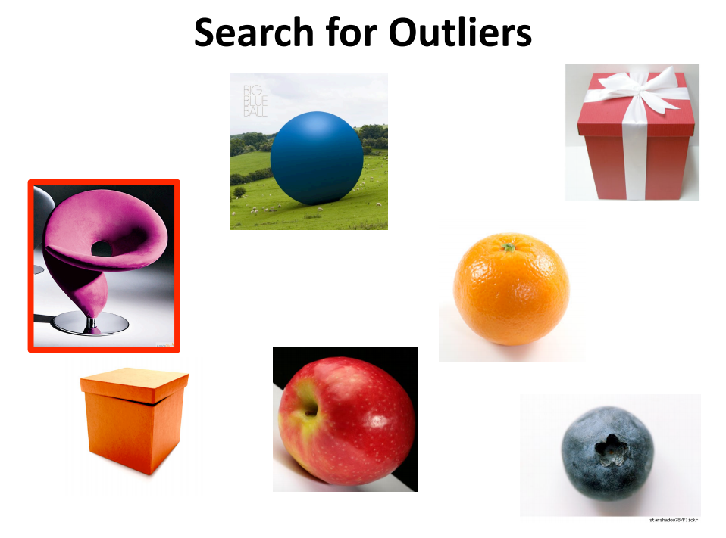

Slide 27
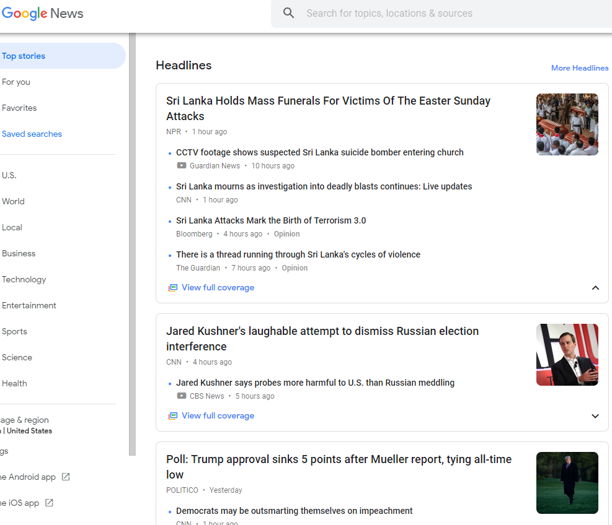
Clustering: Examples

Slide 28
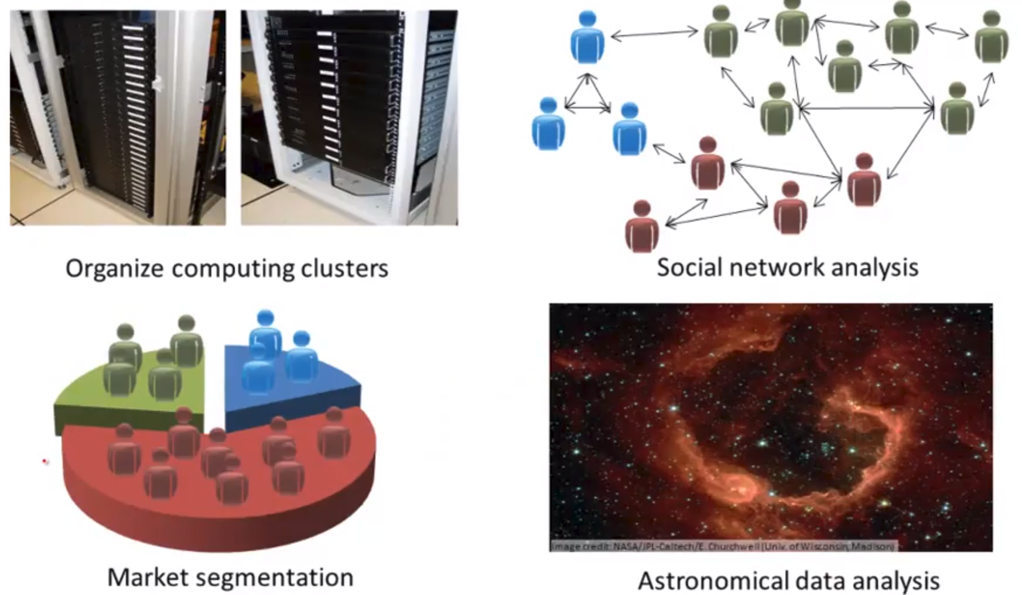
Clustering: Examples

Slide 29
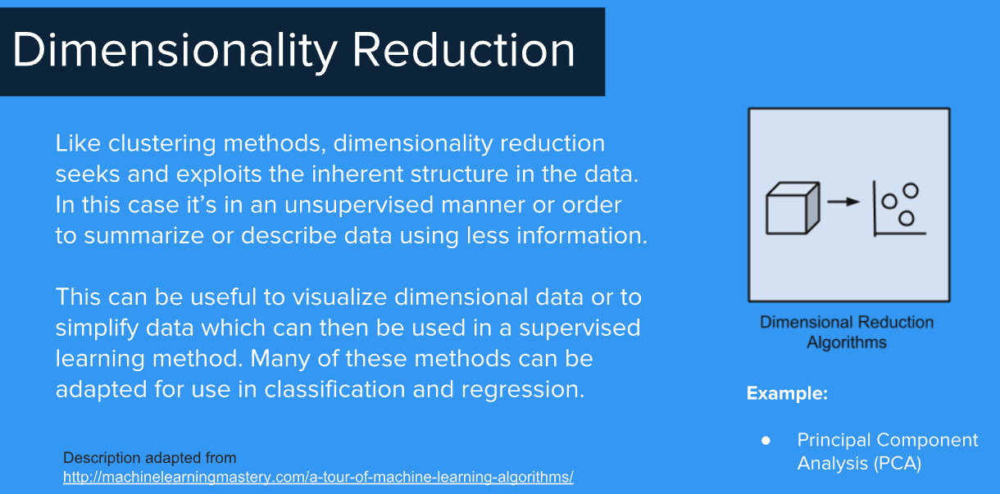
Unsupervised Learning: Dimensionality Reduction

Slide 30
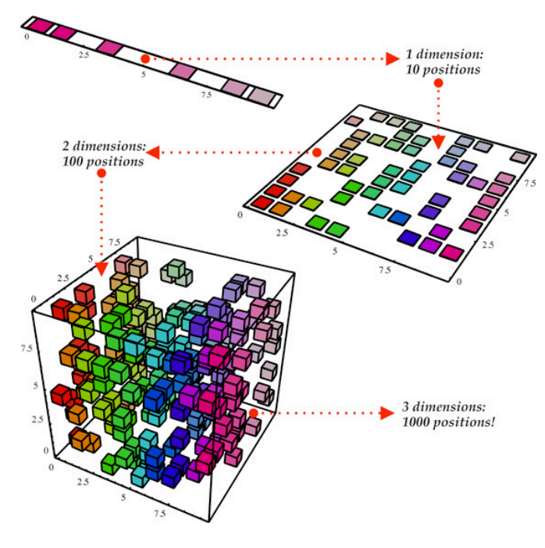
Unsupervised Learning: Dimensionality Reduction

Slide 31

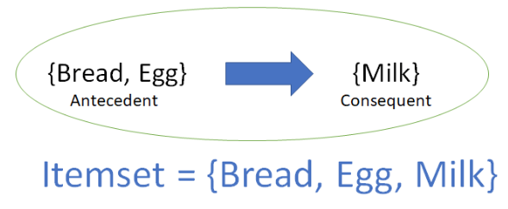
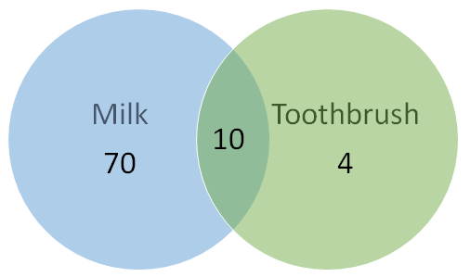
Unsupervised Learning: Association
Association rule: Finding what the customers will most likely buy…i.e., finding the interesting relationships among items

Slide 32
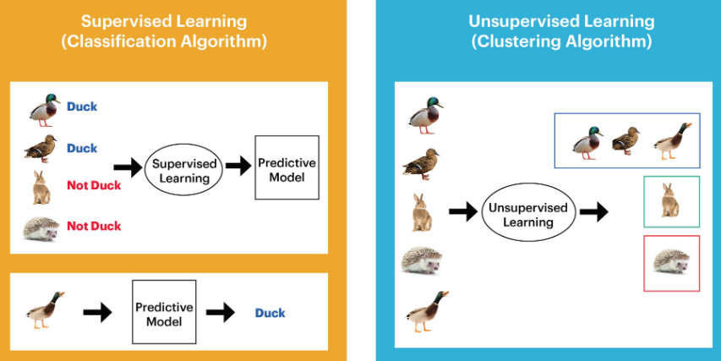
Examples: Supervised vs. Unsupervised

Slide 33
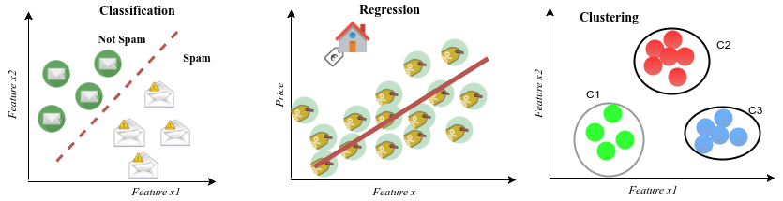
Examples: Supervised vs. Unsupervised

Slide 34
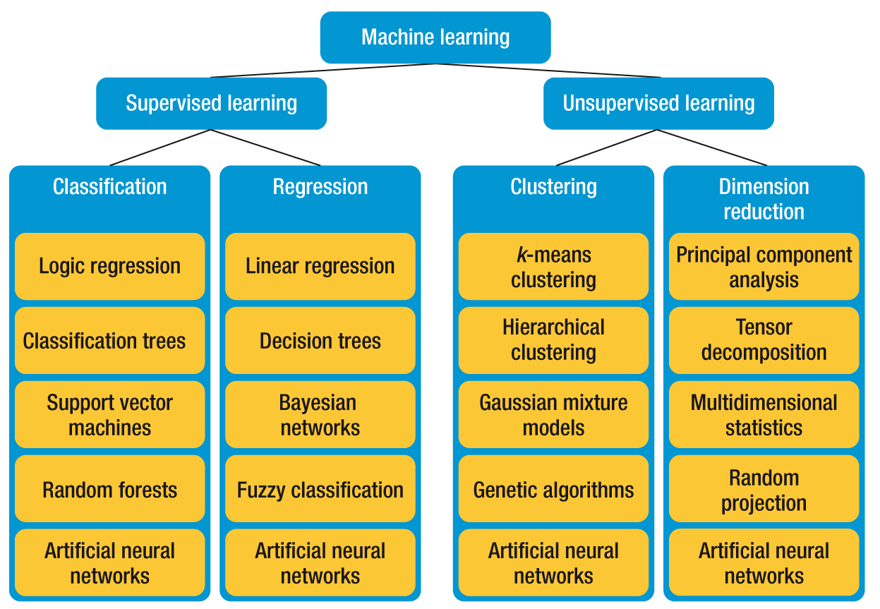
Algorithms

Slide 35
What we will cover Today?
Supervised Learning
- Regression
- Classification
- Decision Trees
Unsupervised Learning
- Clustering
- Dimensionality Reduction
- Association
Quiz

Slide 36


Quiz
Input | Output | Classification | Regression
Credit History | Lend Money?
 | High School, College, Grad
 | Age?

Slide 37
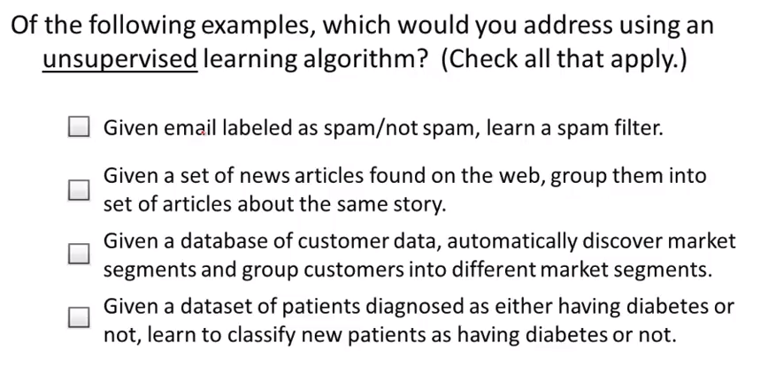
Quiz

Slide 38
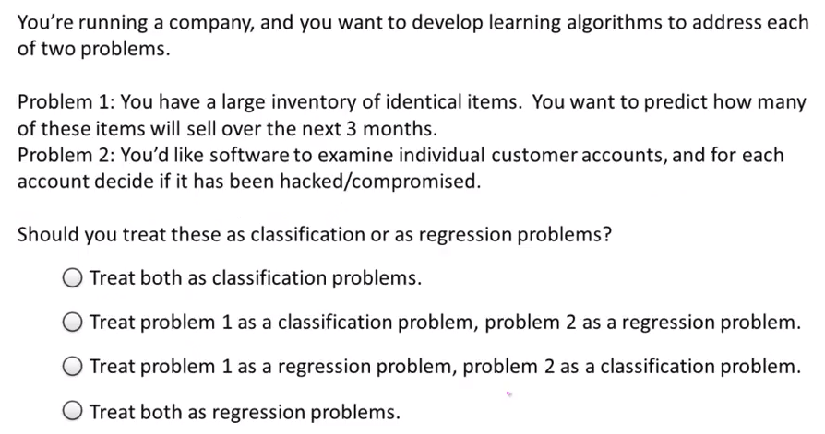
Quiz

Slide 39

Recap: Supervised vs. Unsupervised

Slide 40
Tomorrow?

